Slide 1
K-Means in Image Clustering
Angela Cao
Mentored by Shane McQuarrie
Spring 2020 DRP

Slide 2
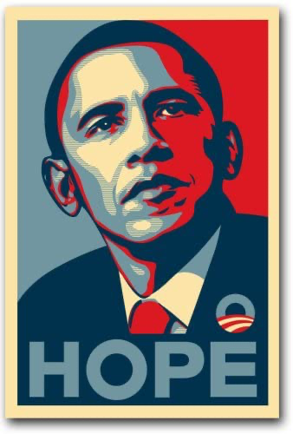
Notes:
This iconic political poster introduced a fun image filter. Can we recreate a similar filter with a little math and code?

Slide 3
Nearest Neighbors
Nearest neighbor problem: given a dataset X = {x_{i}}^{k}_{i=1} and a new point z, what is the point in X that is "nearest" to z?
min_{i} ||x_{i} - z||
K-Nearest Neighbors Classifier: given a dataset X, corresponding labels y, and a new point z, to classify point z and give it a label, find the k labeled data points in X that are “nearest” to z and assign to z the majority label of those nearest neighbors. This is a supervised learning algorithm because we have the labels y.
Find the subset {x_{ij}}^{k}_{j=1} that minimizes Σ^{k}_{j=1} || x_{ij} - z||² Then set y = mode(y_{ij})
Notes:
What does it means to be nearest? We have to pick some sort of norm that defines distance between the data points.
There are lots of ways to go about actually solving the problem, most of which have to do with some sort of clever search of the domain space (like higher-dimensional versions of a binary search tree).

Slide 4
K-Means
K-Means algorithm: given a dataset X, determine k points (“cluster centers”) that define clusters in the data. A point x_{j} is in center i if it is closer to the ith cluster center than to any of the other cluster centers.
This is an unsupervised learning algorithm because we do not have any labels (in general, this is much harder than supervised learning).
Notes:
Take a minute to talk about how unsupervised learning means no labels come with the data.
In some sense, K-means is the opposite of a K-Nearest Neighbor classifier.
The means don’t have to actually be points in X, just in the same space.
Write this out in math language :D
Really need a few figures with simple examples of what this looks like.

Slide 5
The Algorithm
Input: a data set X and a number of clusters k.
Select k initial cluster centers µ₁ … µ_{k} (e.g., choose k points from X).
Until the cluster centers stop changing, iterate:
For each point x_{i} in the data,
Calculate which cluster center µ_{j} the data point x_{i} is closest to (NN)
Define clusters S₁, … S_{k}, where S_{j} is the collection of points that are closer to µ_{j} than to any of the other cluster centers.
Choose new cluster centers as the average of the points in each cluster, that is, µ_{j} = mean(S_{j}).
Output: k final cluster centers µ₁ … µ_{k}.
Notes:
Code summary
Maybe delete the for loop?

Slide 6
import numpy as np
from scipy import linalg as la
def kmeans(X, k, tol=1e-6):
"""Do k-means clustering!
O(mnki) cost where i is the number of iterations.
Parameters
----------
X : (m,n) ndarray
The data to cluster. Each row is an individual
entry in the data set (with n features).
k : int
How many clusters (we have to choose this).
tol : float
Stopping tolerance. Stop the iteration when
|centers_old - centers_new| < tol.
Returns
-------
y : (m,) ndarray
Labels for the clusters, e.g., y[i] = 2 means
X[i,:] belongs to cluster 2.
centers : (k,n) ndarray
The centers of the final clusters.
"""
Notes:
Python code.

Slide 7
def kmeans(X, k, tol=1e-6):
m,n = X.shape
# Get k initial cluster centers by choosing points in X.
centers = X[np.random.choice(m, k, replace=False)]
# Do the iteration: decide which center each row is closest to.
distances = np.empty((m,k)) # distances[i,j] = |X[i] - center[j]|
diff = np.inf
while diff > tol:
# Calculate distances.
for j in range(k):
distances[:,j] = la.norm(X - centers[j], axis=1, ord=2)
# Choose the smallest distance for each point.
y = np.argmin(distances, axis=1)
# Update the centers.
centers_new = np.empty((k,n))
for j in range(k):
centers_new[j] = np.mean(X[y == j], axis=0)
# Calculate the difference between old and new centers.
diff = la.norm(centers - centers_new, ord=2)
# Update.
centers = centers_new
return y, centers
Notes:
Body of Python code.

Slide 8
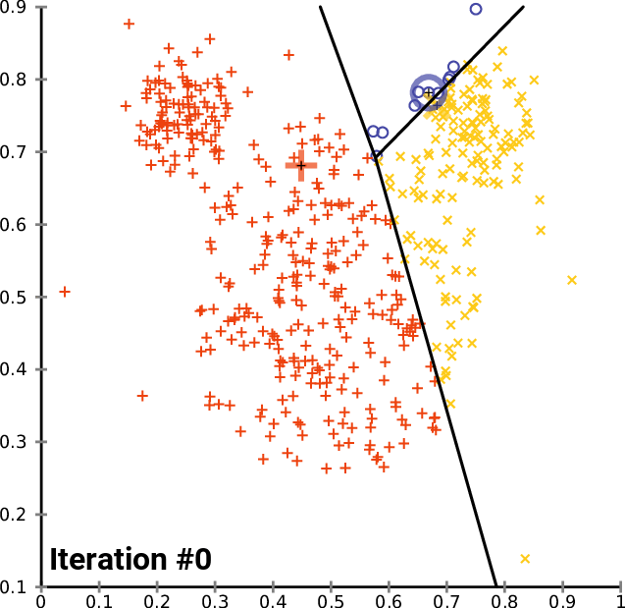
The Iteration
Notes:
Source: https://en.wikipedia.org/wiki/K-means_clustering#Algorithms. This is a visualization of how the clusters (and the cluster centers) evolve as the algorithm progresses.

Slide 9
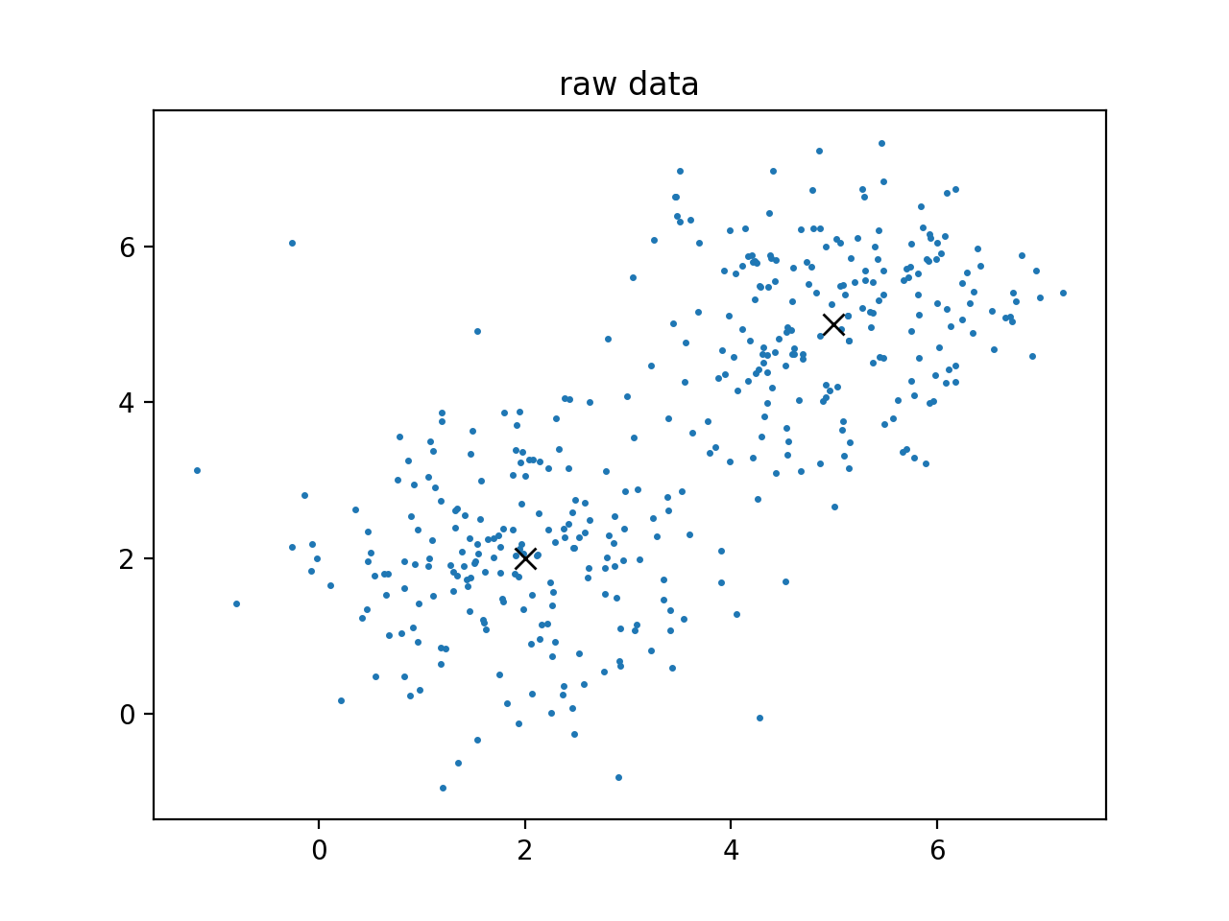
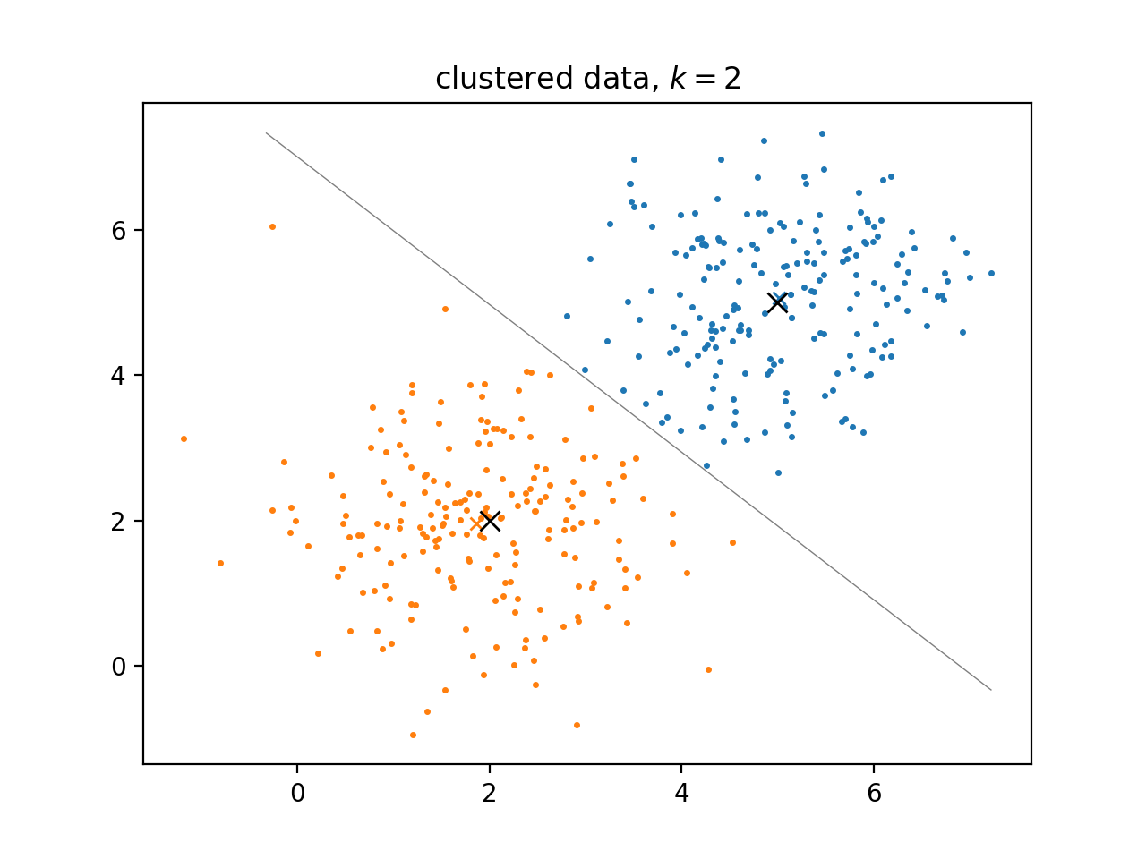
Example: 2D Data
Notes:
This algorithm does really well when there are actual clusters in the data and we know how many there are (i.e., k is correct).
With just the cluster centers, we can define a nice boundary between the clusters.

Slide 10
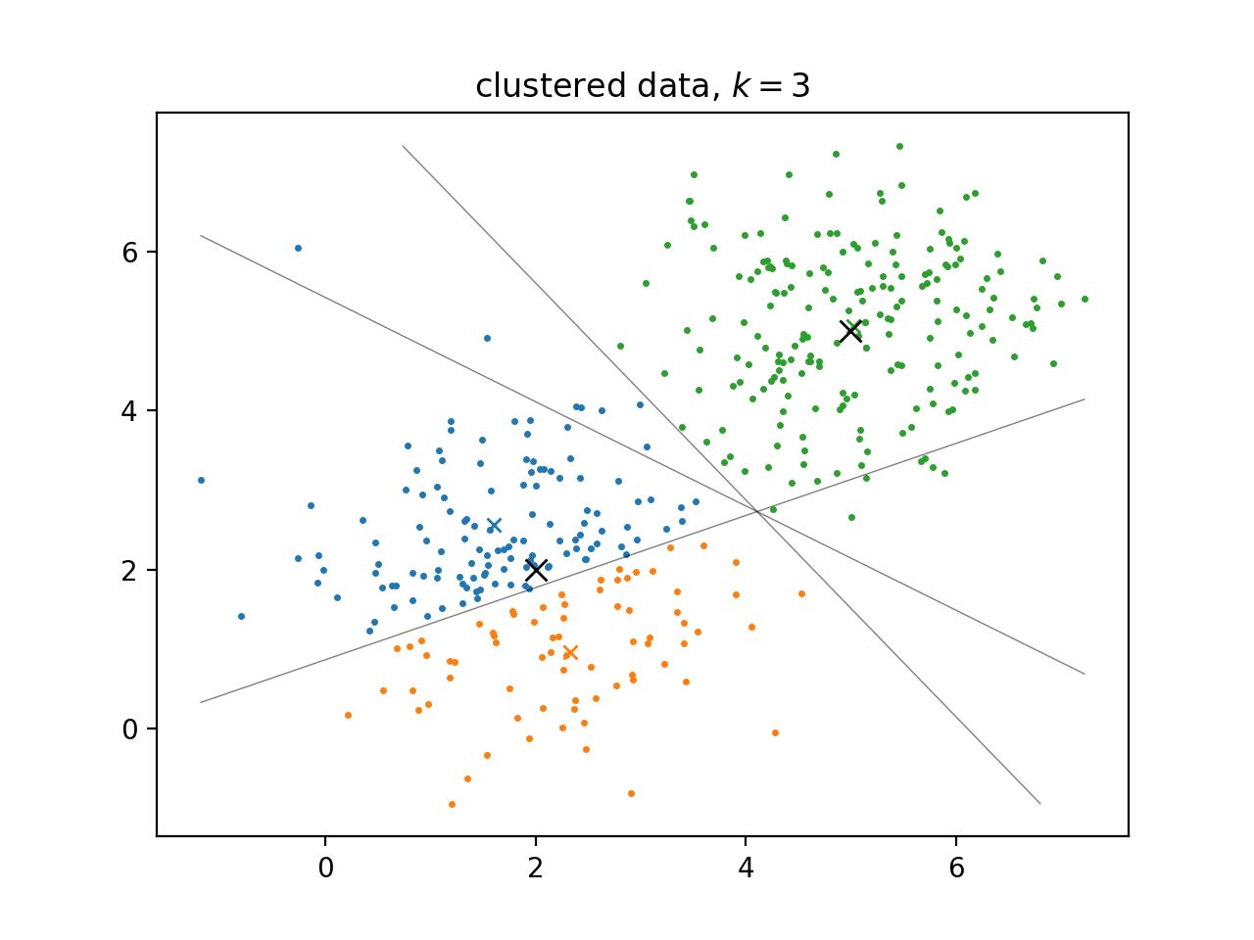
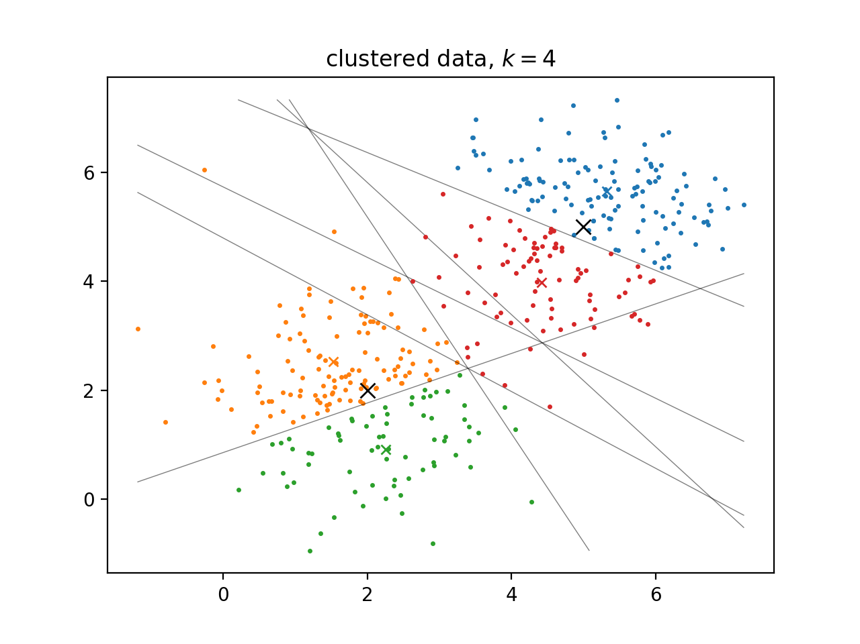
Example: 2D Data (bad number of clusters)
Notes:
But if we have a bad number of clusters (k is incorrect) or there are no distinct clusters in the data, this can go wrong.
In higher dimensions, it can also be difficult to visualize the clusters / determine if the clusters are reasonable.

Slide 11
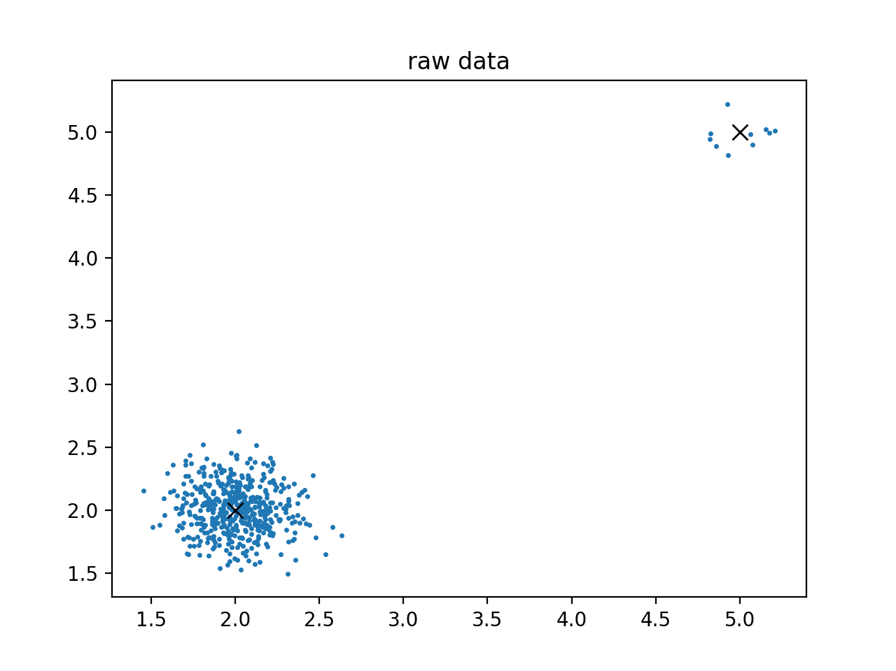
Example: 2D Data (class imbalance)
Notes:
How does k-means do when there is a heavy class imbalance (meaning lots of data in one cluster, and not much data in another)?

Slide 12
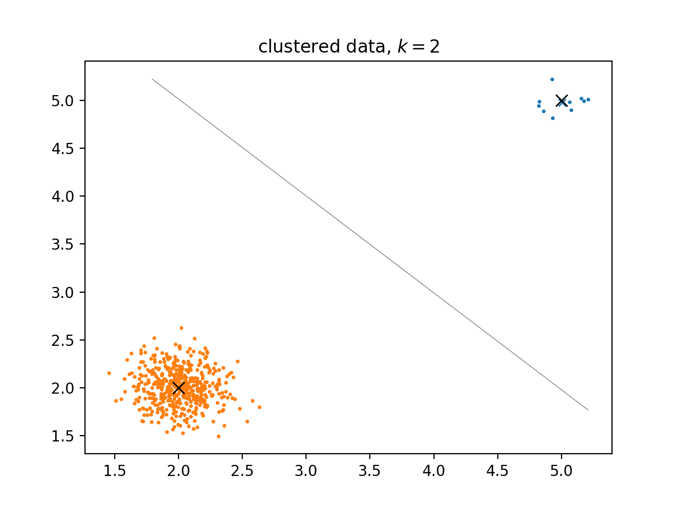
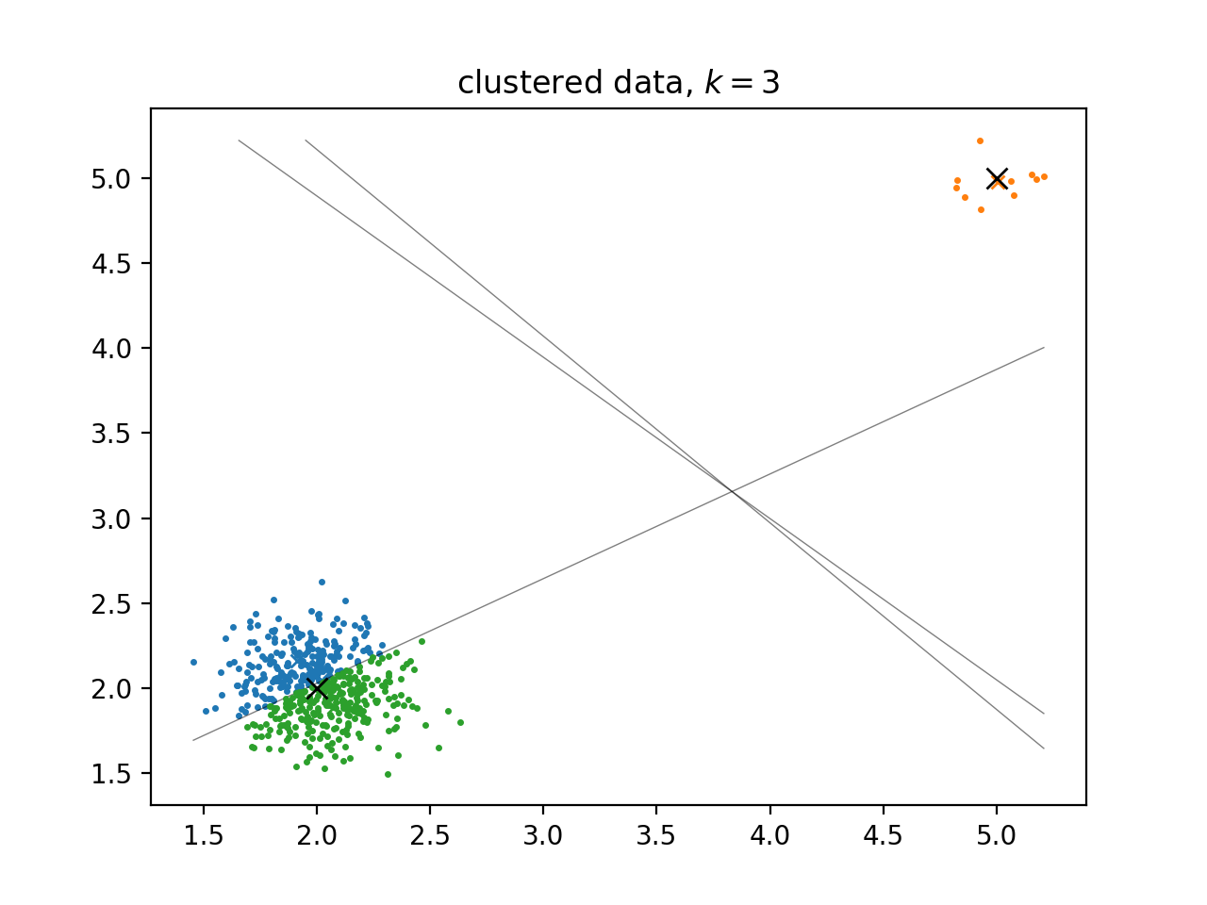
Example: 2D Data
Notes:
Pretty well, at least in this simple case. As long as you have the right number of clusters. It can still go horribly wrong if k is bad.

Slide 13
Pros Cons
It does clustering, which is very hard in general.
Relatively inexpensive with an algorithmic complexity of O(mnkd).
Simple and easy to implement.
The general problem of finding the best clusters is NP-hard and our solution is only an approximation.
We have to choose k beforehand and there isn’t always a great way to determine if your choice was good or not.
You can get different results if you choose different starting points for the cluster centers (though there are ways to try to cleverly choose “good” starting points).
If you have one huge cluster (lots of points) and one small cluster (few points), you can get unsatisfactory results.
Notes:
Dimensions: m = number of data points, n = number of features, k = number of cluster centers, d = number of iterations until convergence.

Slide 14
Applications of K-Means: Pixel Quantization
Our goal is to approximate a natural image with only k colors (this can be good for compression, and it also just looks cool). Specifically, we will use k-means clustering on image data to organize all the pixels into k color groups.
The data set X is the original image; each point x_{i} in the data is a single pixel. The cluster centers that we get from k-means should be representative of the image (and much better than choosing random colors from the image).

Slide 15
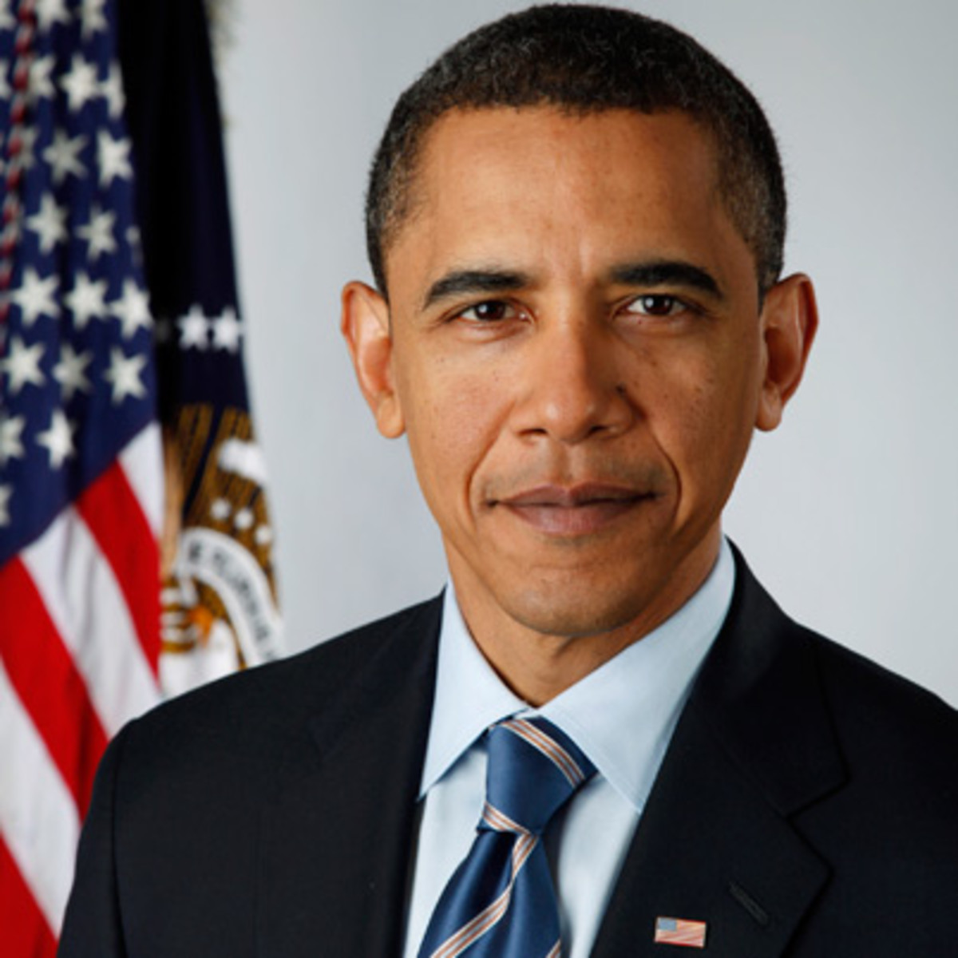
Applications of K-Means: Pixel Quantization
=
Notes:
Take a picture (which is stored in a computer as a 3D array of color values, usually integers from 0 to 255) from a 3D matrix/array of RGB to a 2D array (by stacking the entries of the left matrix/array carefully). So every row of the 2D array represents one pixel of the original picture, and this is the data set that we do clustering on.
Ex. bottom left pixel is a red, so that its R value is 255 while its G and B values are 0.

Slide 16
import imageio
import numpy as np
from scipy import linalg as la
From sklearn.cluster import KMeans
def cluster_image(im, k):
"""Cluster image pixels.
Parameters
----------
im : (r,c,d) ndarray
Original color image.
k : int > 0
Number of clusters.
Returns
-------
imnew : (r,c,d) ndarray
Clustered color image.
"""
Notes:
“Pseudocode”

Slide 17
# Get the dimensions of the image.
nrows, ncols, ndim = im.shape
m = nrows * ncols # number of pixels.
n = ndim # number of features per pixel.
X = im.reshape((m,n)) # reshape the data for clustering.
# Do the clustering algorithm with our KMeans function.
y, centers = kmeans(X, k)
# # Alternatively, do the clustering algorithm with Scikit-learn.
# Xclustered = KMeans(n_clusters=k, n_init=5).fit(X)
# centers = Xclustered.cluster_centers_
# y = Xclustered.predict(X)
# Post-process the cluster centers for image purposes.
centers = np.clip(centers, 0, 255).astype(np.uint8)
# Create the new picture.
Xnew = np.empty_like(X)
for j in range(k):
Xnew[y == j] = centers[j]
imnew = Xnew.reshape(im.shape)
return imnew
Notes:
“Pseudocode”

Slide 18
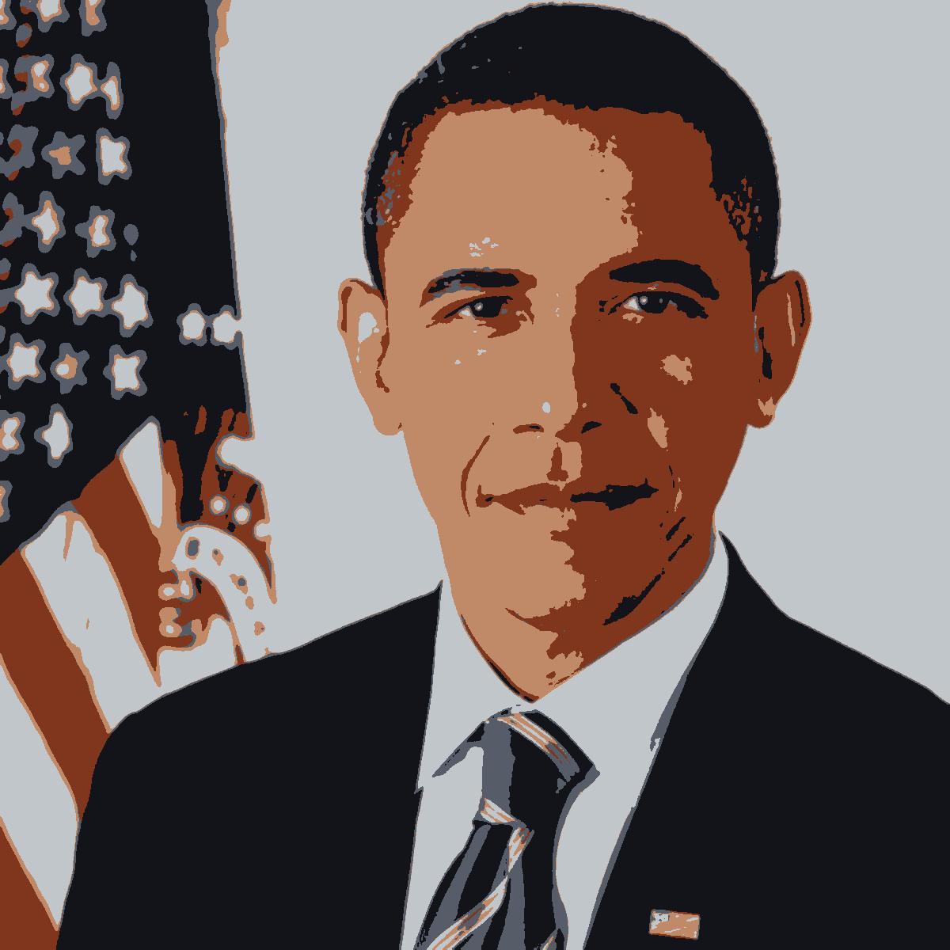
Results
Original
Clustered, k = 5
Notes:
Provide examples for k = 2 and k = 10 as well.

Slide 19
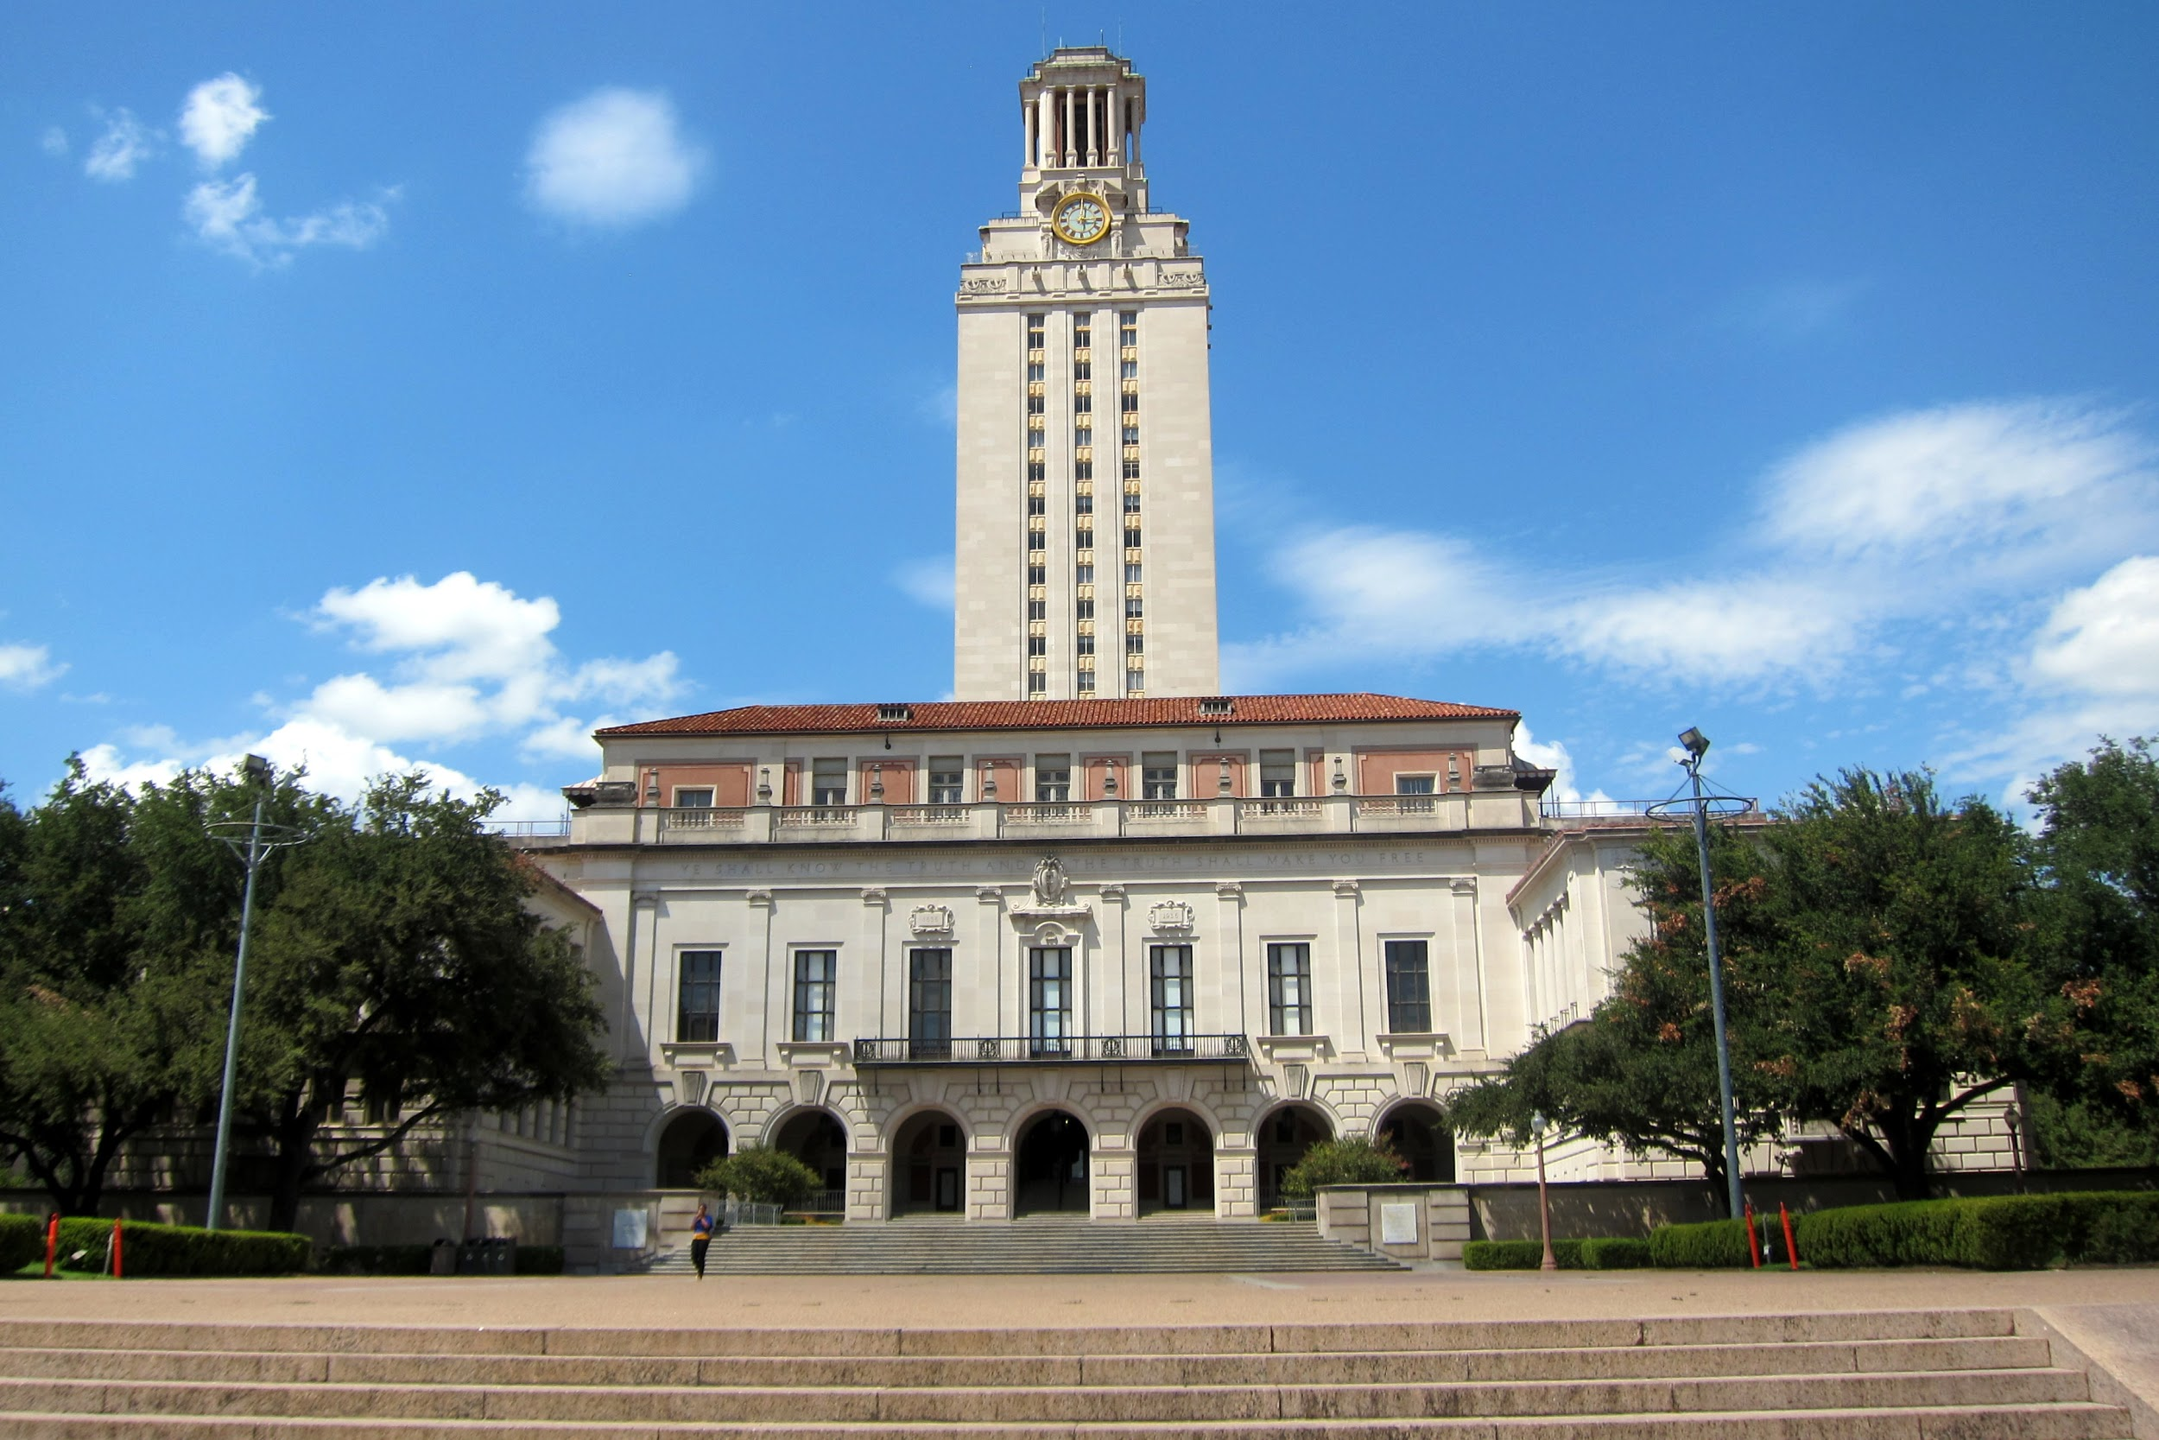
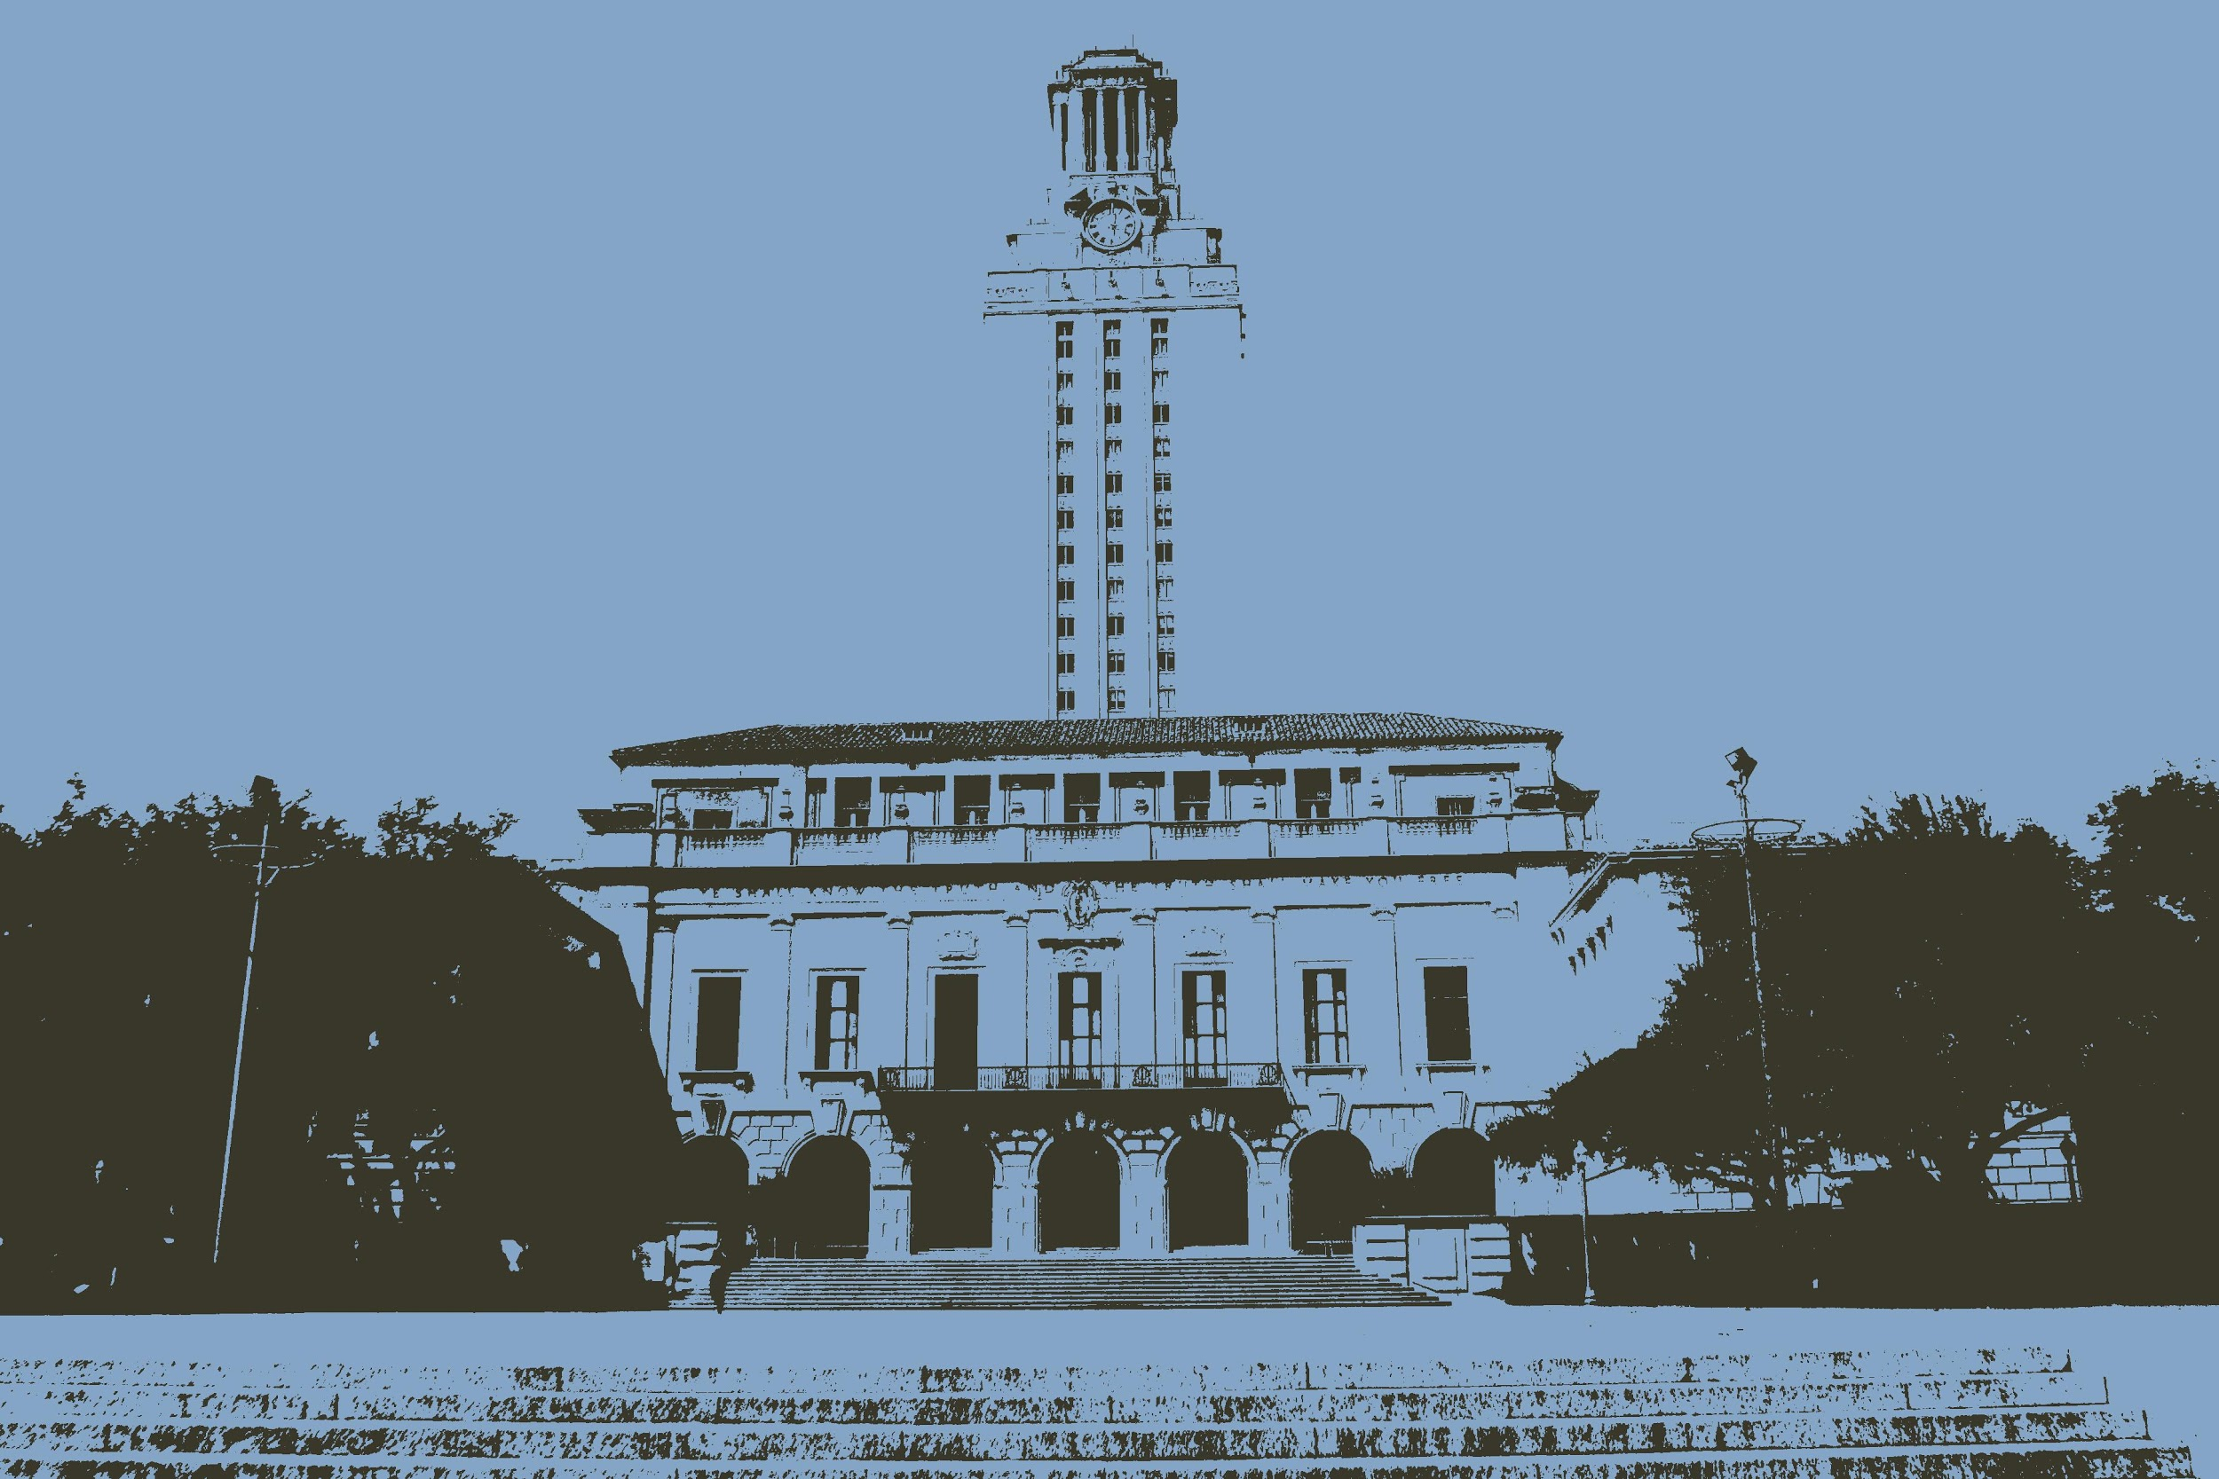
Results
Original
Clustered, k = 2

Slide 20
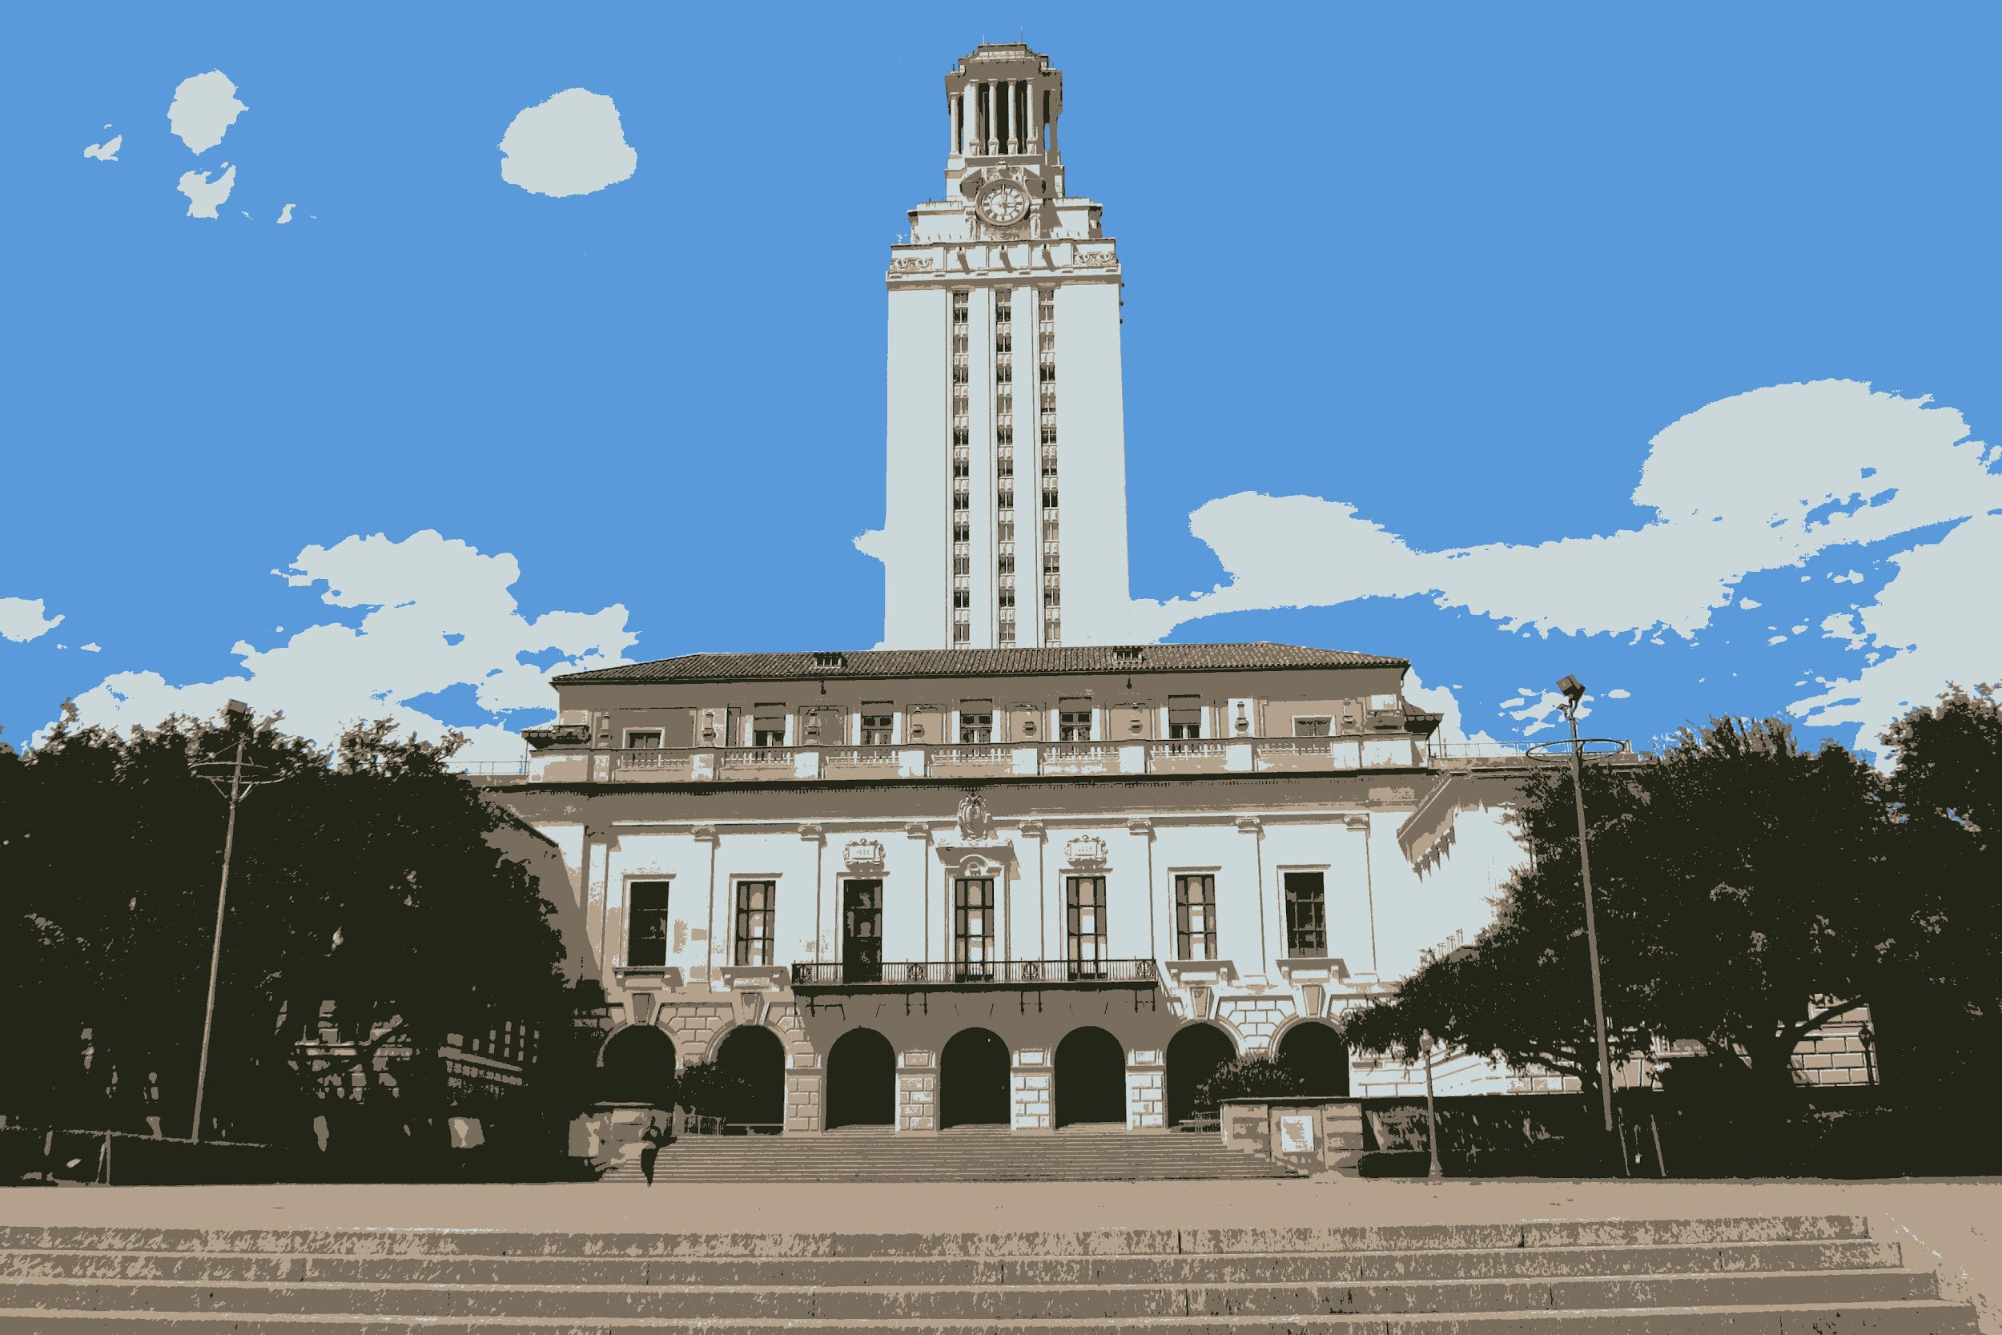
Results
Original
Clustered, k = 5

Slide 21
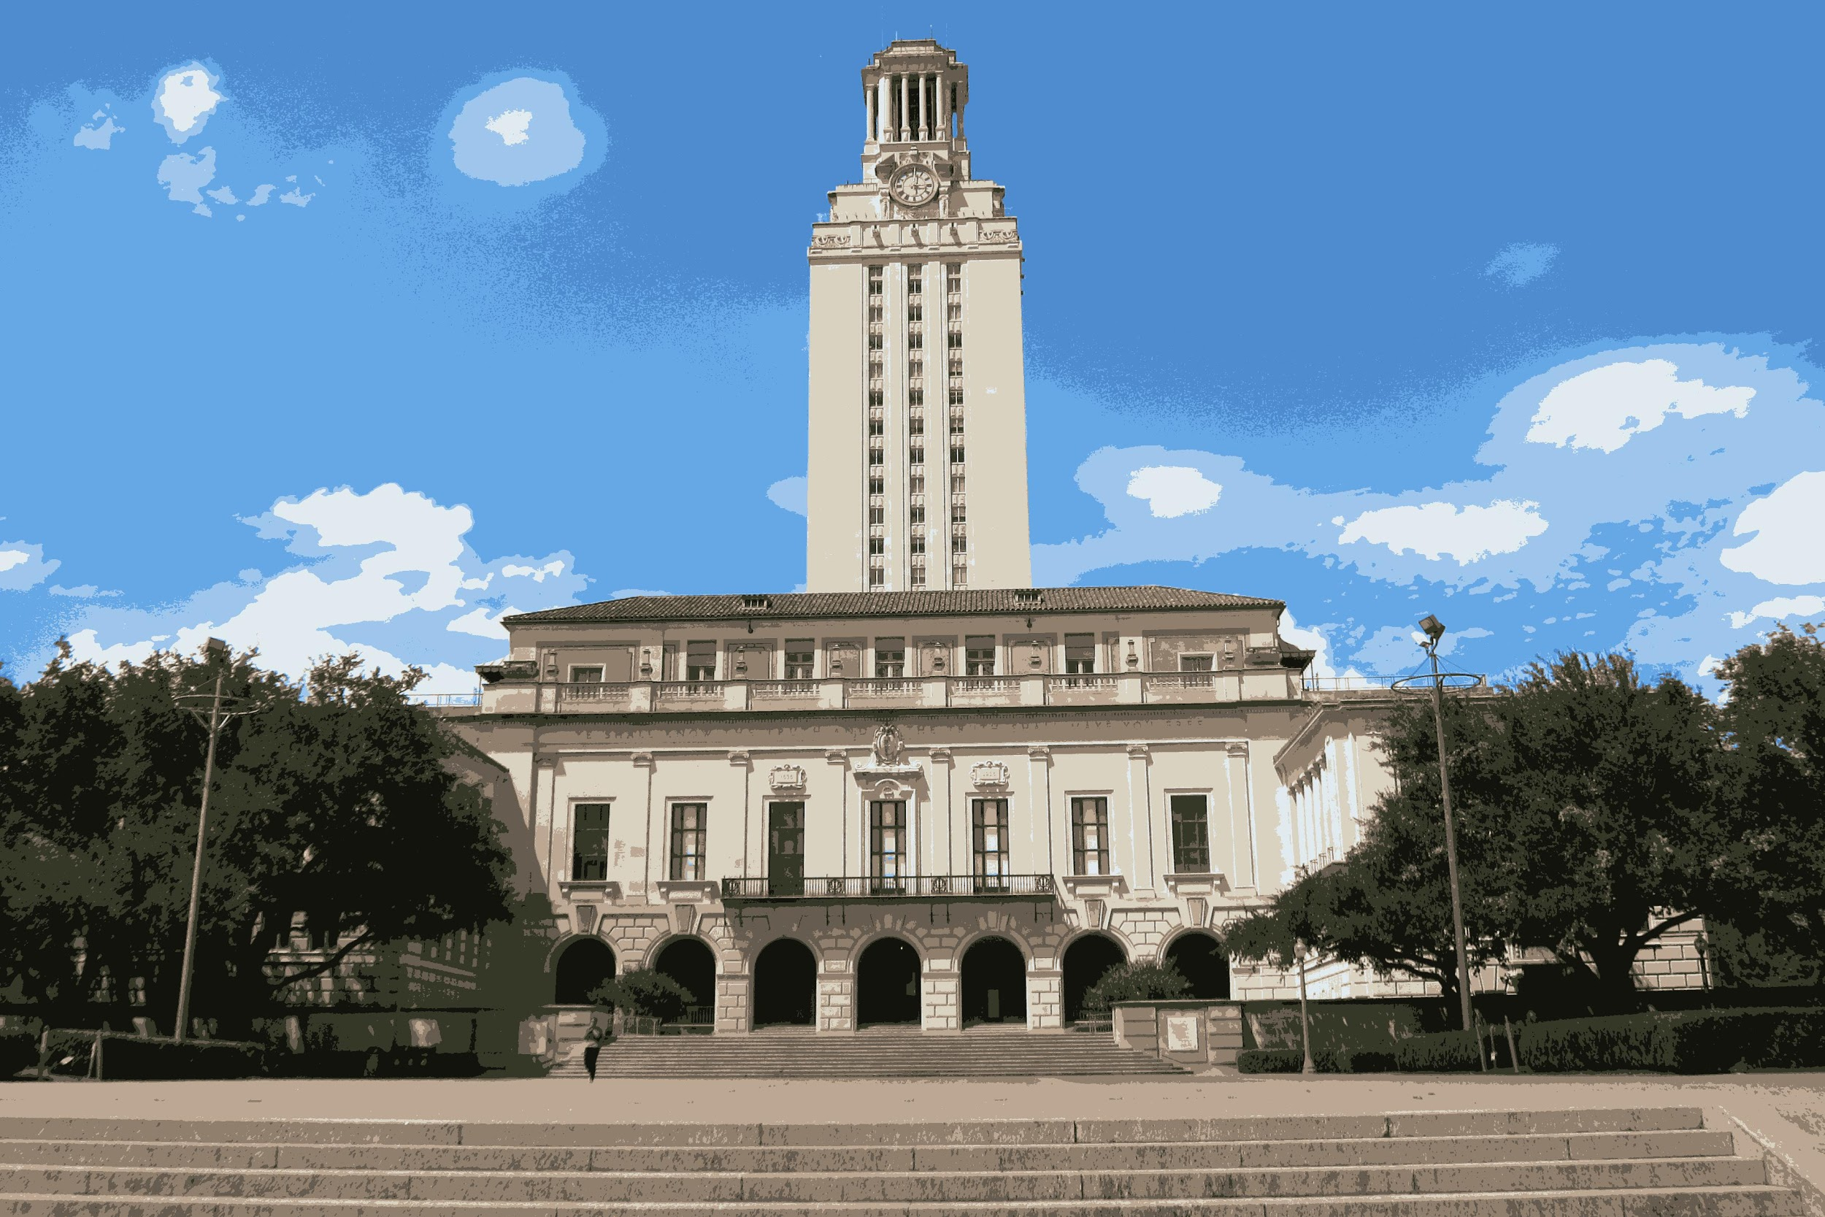
Results
Original
Clustered, k = 10

Slide 22
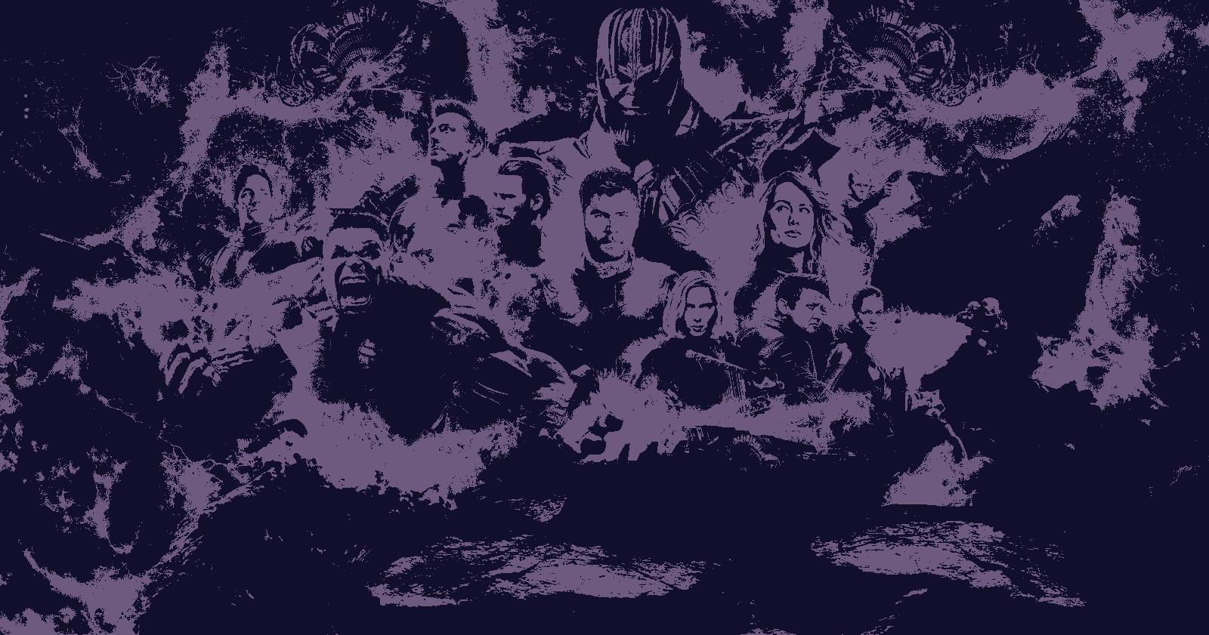
Results
Original
Clustered, k = 2

Slide 23
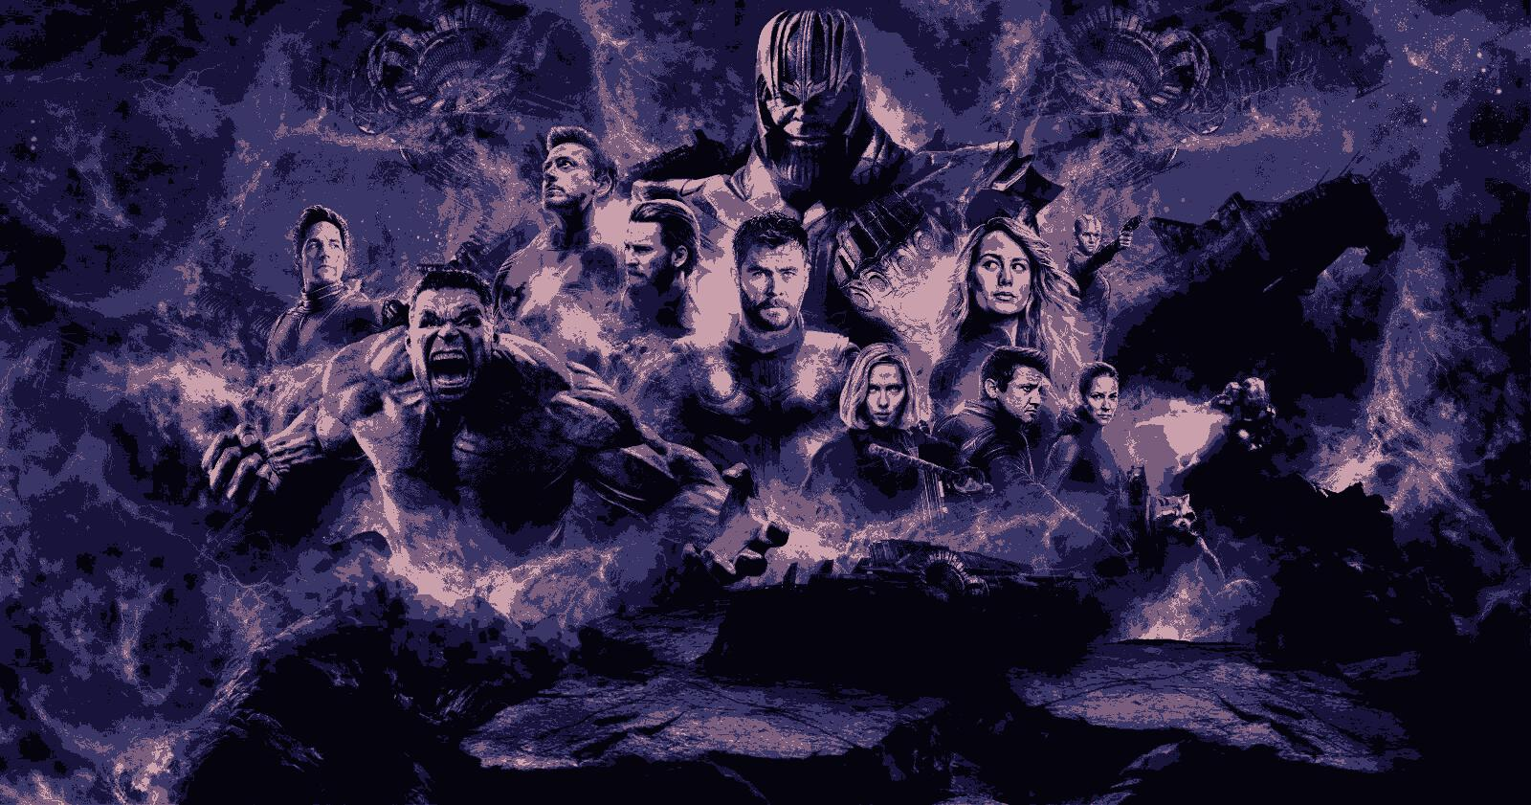
Results
Original
Clustered, k = 5

Slide 24
Results
Original
Clustered, k = 20

Slide 25
Summary
Nearest Neighbors is a supervised learning problem that shows up often in computer vision, image processing, and other machine learning tasks.
K-Means is an unsupervised learning algorithm for clustering. It can be thought of as the inverse of the k-nearest neighbors algorithm.
We can apply K-Means to Pixel Quantization, resulting in an image filter algorithm. The larger the constant k, the more accurate the altered picture will be to the original.

